Slide 1
GITHUB AGGREGATOR Pre Final - Review

Slide 2
PROJECT DETAILS
PROJECT NAME:
GitHub Aggregator - A GitHub aggregator is a tool that gathers and consolidates data from multiple GitHub repositories, enabling users to monitor and analyze activities across projects from a centralized platform.
PROJECT STATEMENT:
Create an Api Service to fetch the statistics of the contributors of user-specified GitHub repositories in the Amazon Web Services Environment.
GROUP NO: 2
GROUP MEMBERS:
Priyadarshini J
Vishal
Bhargavi Mathad
Akshatha I Hiremath
Jyothi Hulkund

Slide 3
Roles and resposibilities
Vishal : Handling the Code with presentation.
Priyadarshini J : Project Coordinator
Bhargavi Mathad : Creating an AWS API gateway
Akshata I Hiremath : Document Leader
Jyothi Hulkund : Team Supporting

Slide 4
METHODOLOGY : Analyzing GitHub Repository Commit Data
Importing Necessary Packages/Libraries : Import required libraries such as requests, pandas, pymysql, and datetime to set up the environment for data retrieval, processing, database interaction, and time handling.
Taking User Input : Prompt the user to input the GitHub repository name, start date, and end date to customize the data retrieval process.
Setting Default Values : Set default values for the start date ('2010-01-01') and end date (today's date) if the user does not provide them.
Defining Variables : Initialize various variables such as access token, headers, run date, data frames, and dictionaries to store and manipulate data throughout the code execution.
Fetching Commit Data from GitHub API : Construct URLs based on user input to send HTTP GET requests to the GitHub API and retrieve commit data within the specified date range.
Pagination Handling : Iterate through multiple pages of commit data if the response from the API contains pagination, ensuring all relevant commits are retrieved.

Slide 5
Processing Commit Data : Extract relevant information from the retrieved commit data, such as email IDs, company names, and dates, and store it in dictionaries for further analysis.
Calculating Contribution Metrics : Calculate metrics like total contributions and unique contributors based on the processed commit data to gain insights into contribution patterns within the specified date range.
Printing Results : Print various statistics and output, including total pages of commit data, total companies contributing, total contributions, unique contributors, languages used, and the output JSON data.
Storing Data in Database : Establish a connection to a MySQL database and store the processed data for future retrieval and analysis. Insert the data into the database and commit the changes to ensure data integrity.
Error Handling : Include a try-except block to handle exceptions gracefully and print informative error messages to aid in troubleshooting if any errors occur during execution.
Execution Time : Calculate and print the execution time of the script to provide insights into its performance.

Slide 6
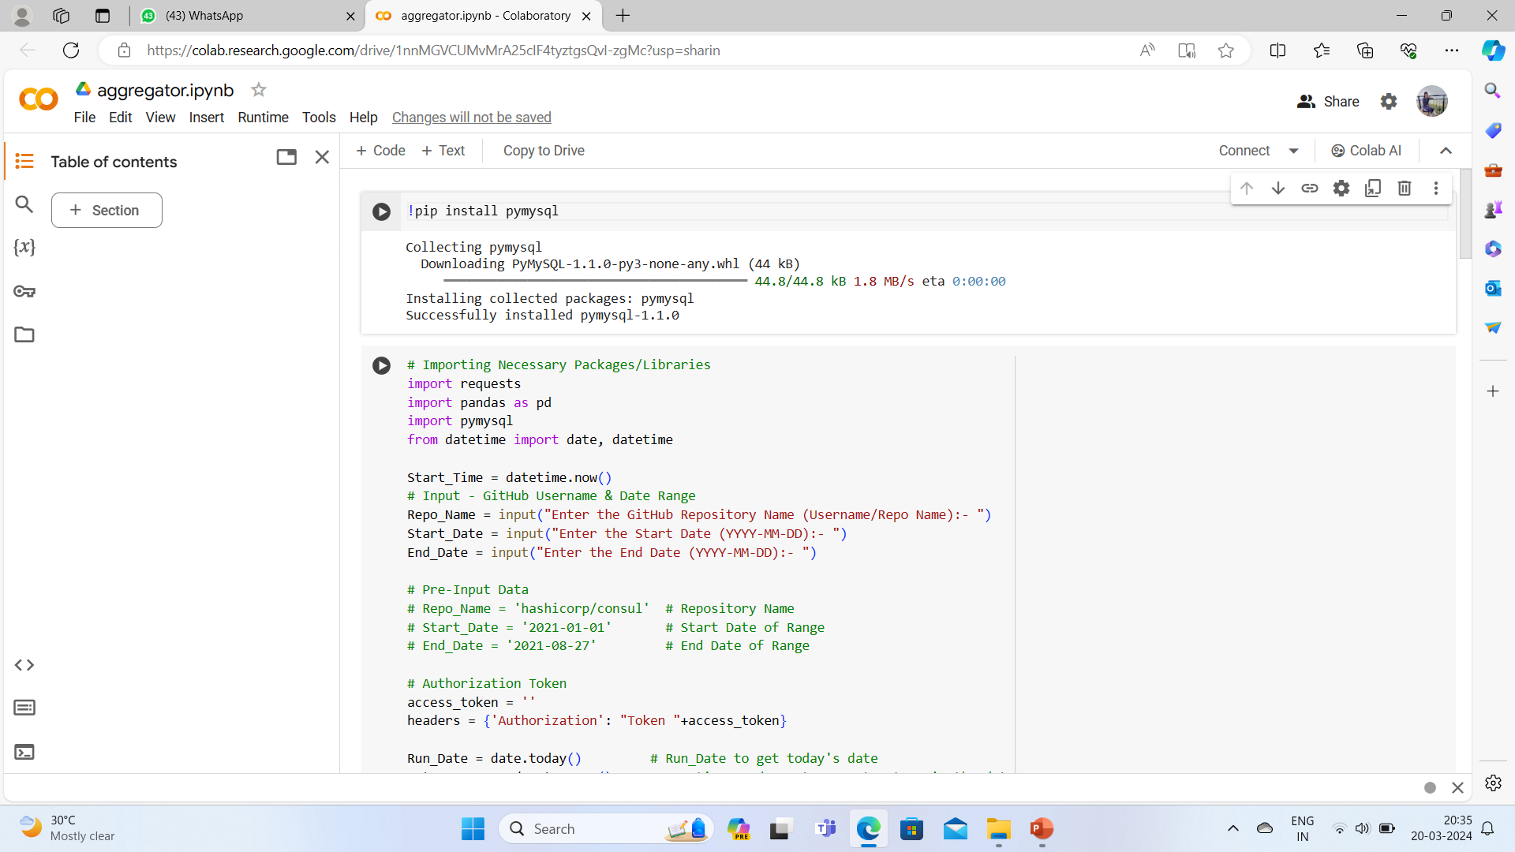
OUTPUT

Slide 7
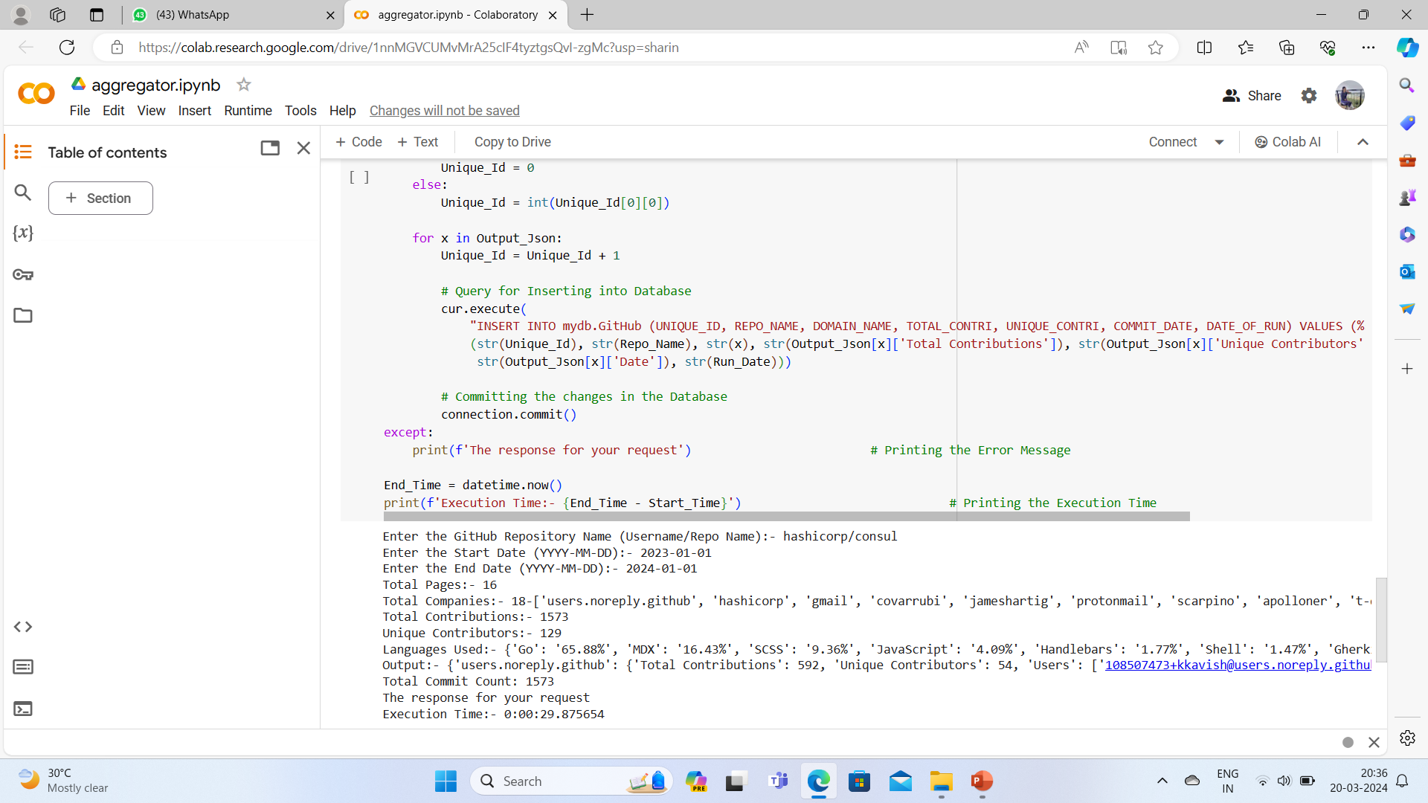
OUTPUT

Slide 8
CONCLUSION
Overall, the project involves fetching GitHub repository data, processing it, storing it in a database, and providing statistical insights.
This project effectively collects, processes, and stores GitHub repository data, providing valuable insights into project activity and contributors within a specified timeframe. It serves as a useful tool for analyzing repository metrics and tracking project progress over time.

Slide 9
THANK YOU

